Slide 1
CNN in BCI with fNIRs for move/rest classification task
Convolutional vs conventional approaches

Slide 2
Objectives and contribution

Slide 3
Intro
BCI-fNIRs- motor execution classes: left, right, and rest
CNN to automatically extract the features from the hemodynamic response signal.
To answer:
(1) does CNN outperform conventional methods in fNIRS-based BCI?
(2) How well does CNN work with the input data of the hemodynamic response signal?

Slide 4
Conventional pipeline vs convolutional pipeline
Data acquisition
Data pre-processing:
Denoising and local filtering
Data processing: feature extraction
Data classification and machine learning
Motor execution classes: rest, right, and left
Local features: Laplacian filters & Wavelet for spatial and temporal filtering
Global features: PCA & ICA (unsupervised learning)
Classification (supervised learning)
Data pre-processing
Convolutional NN (CNN): local feature extraction & global & classification

Slide 5
Conventional pipeline vs convolutional pipeline
Data acquisition
Local spatial and temporal features and filtering for denoising:
Spatial Laplacian filters &
Temporal Wavelet
Manual features: mean, peak, skewness and kurtosis (momentums)
Stepwise LDA (e.g. BCI 2003) and naive bayesian classifier
Motor execution classes: rest, right, and left
Global features: PCA & ICA (unsupervised learning)
ANN and SVM
Convolutional NN (CNN): local feature extraction & global & classification

Slide 6
End-to-End approach?
Data
Local spatial and temporal features and filtering for denoising:
Spatial Laplacian filters &
Temporal Wavelet
Manual features: mean, peak, skewness and kurtosis (momentums)
Stepwise LDA (e.g. BCI 2003) and naive bayesian classifier
Classes
Global features: PCA & ICA (unsupervised learning)
ANN and SVM
Convolutional NN (CNN): local feature extraction & global & classification
End-to-End very Deep Convolutional NN (CNN): local feature extraction, global feature extraction & classification???

Slide 7
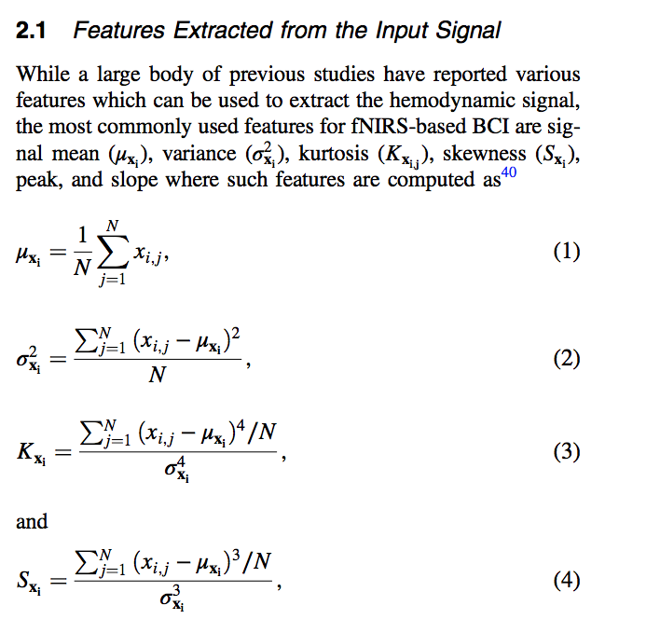
Conventional approaches
The extracted manual features for ANN and SVN classification

Slide 8
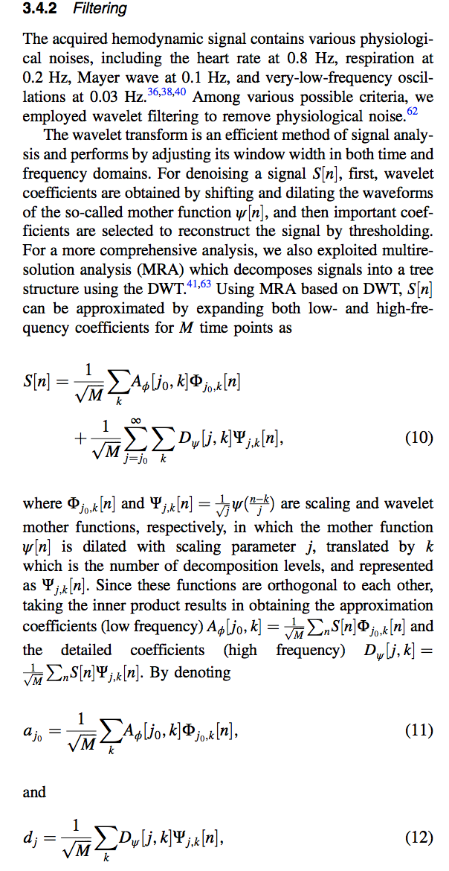
Filtering
Wavelet and Multi resolution filter

Slide 9
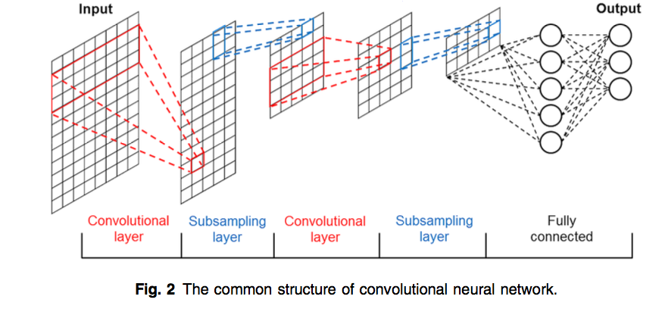
xx%
Use this slide to show a major stat. It can help enforce the presentation’s main message or argument.

Slide 10
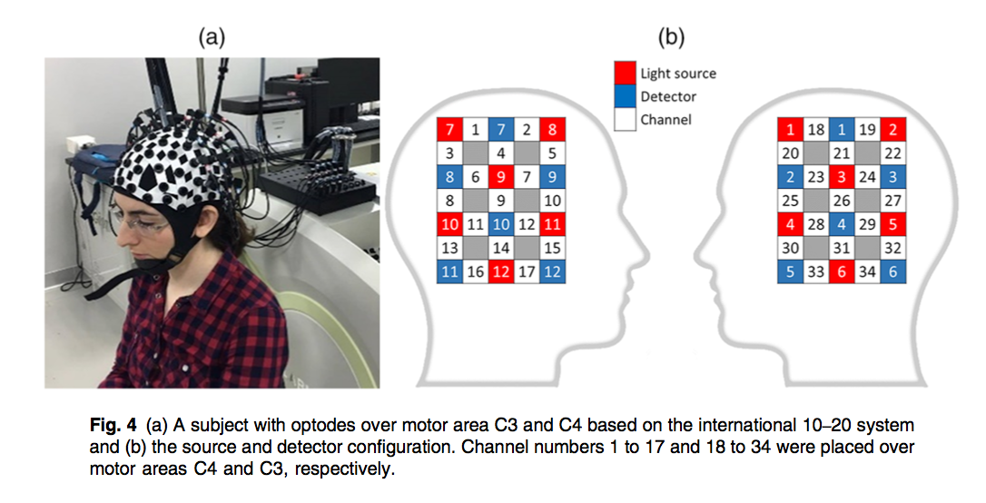

Slide 11
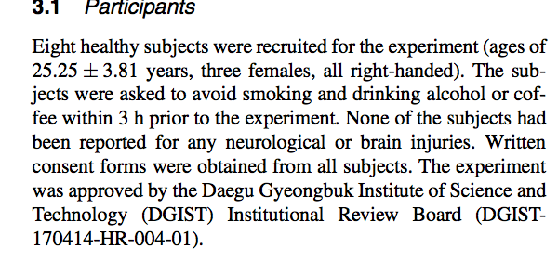

Slide 12
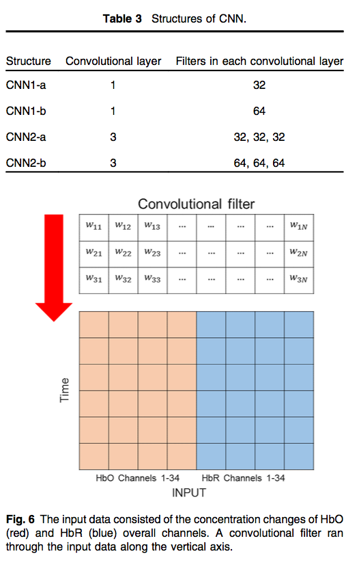
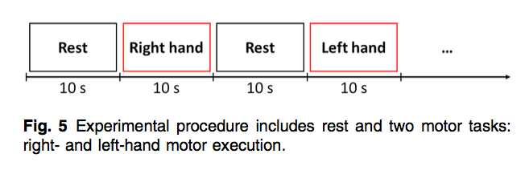

Slide 13
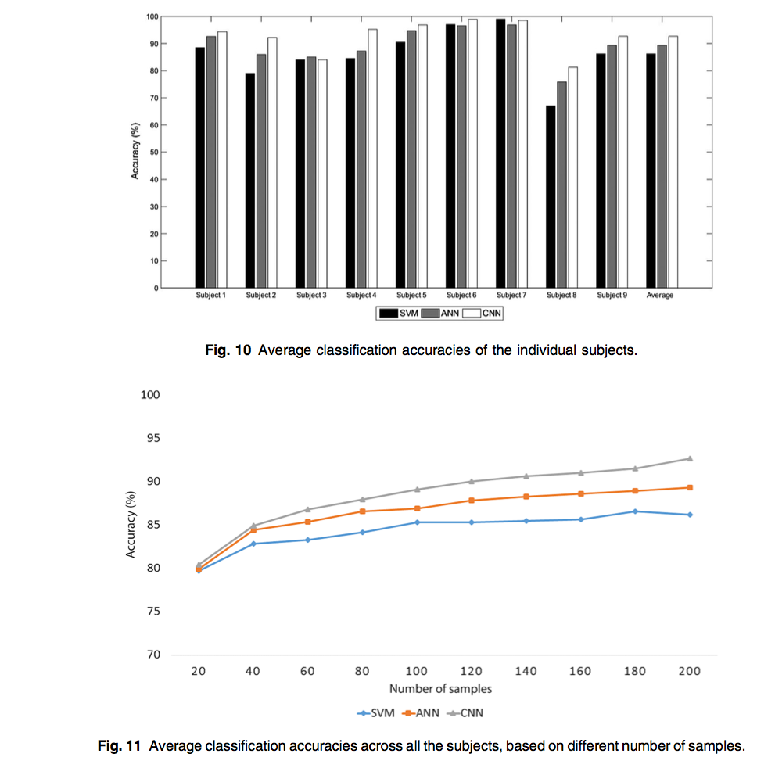
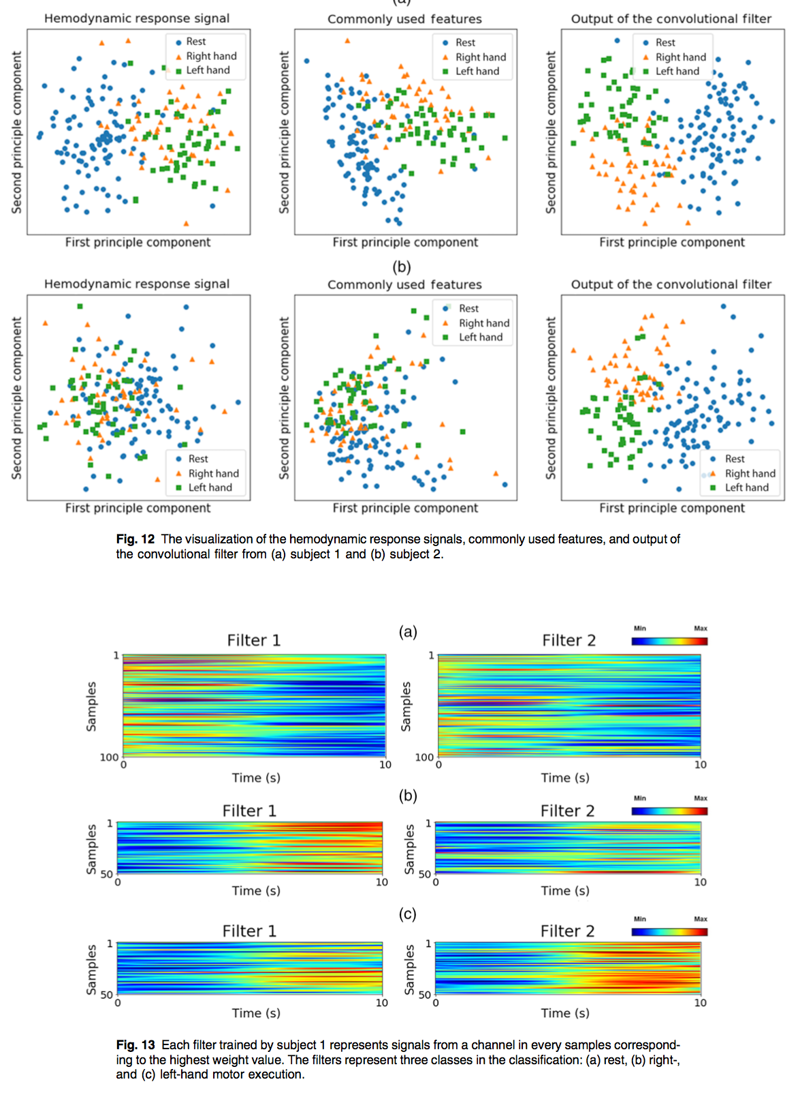

Slide 14
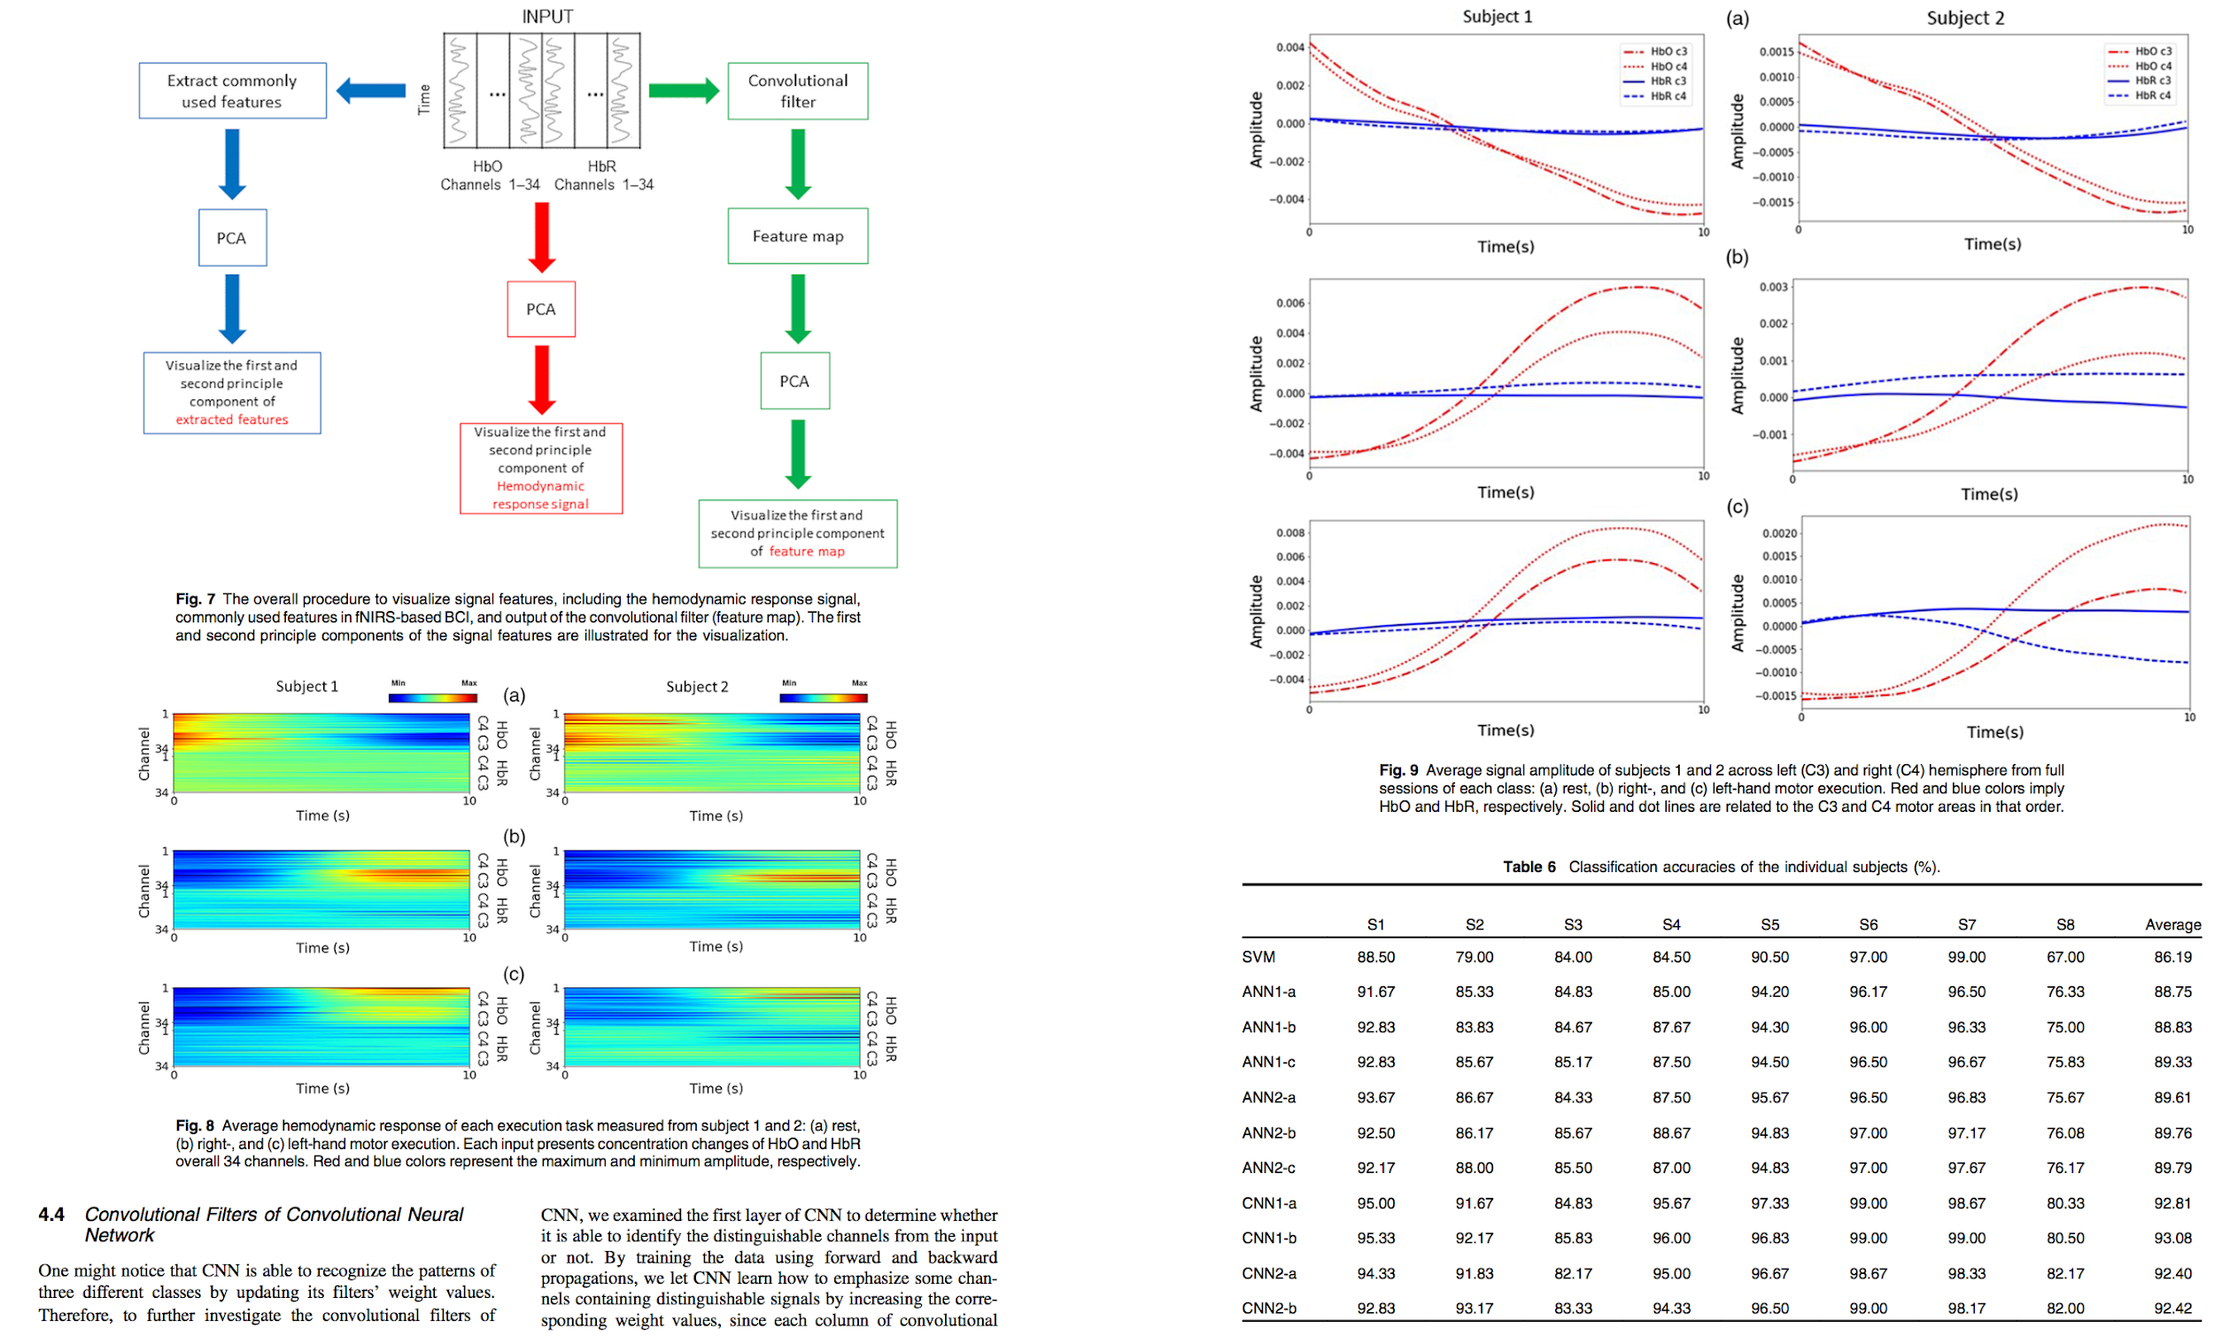

Slide 15

Final point
Convolutional vs conventional: convolutional wins on BCI classification task

Slide 16
The BCI classification task has the potential to be a lot easier and adaptive/ scalable to new collected data.

Slide 17
“Try to make things simple enough but not simpler than that”
- Probably from Einstein
Provable by Heisenberg uncertainty principle

